Slide 1

Types of sampling methods

Slide 2
Learning Objectives
By the end of this session, you will be able to:
Understand the concept of sampling.
Understand different types of sampling and their use case.
Implementation of sampling techniques in Python!

Slide 3
What is Sampling?
Selecting a subset from a larger population.
Saves time, cost
Enables conclusions.

Slide 4
Why is Sampling Important?
✅ Populations too large to fully study
✅ Reduces effort
✅ Provides valid results

Slide 5

Random Sampling
Each member has equal chance.
Simple Random Sampling is used when you want a straightforward and fair representation of the entire population.
Randomly picking 10 passengers from 100 Titanic passengers. Each has a 10% chance of being selected.

Slide 6
Stratified Sampling
In stratified sampling, the population is
divided into groups (strata)
based on an important characteristic (like gender), and
then samples are drawn proportionally from each group.
This ensures your sample respects the structure of the population.
Formula: (stratum size / population size) × sample size.

Slide 7
Stratified Sampling
A college has 800 students: 600 UG, 200 PG.
You want to sample 100 students using stratified sampling technique. How many students from UG and PG will be in your sample?

Slide 8
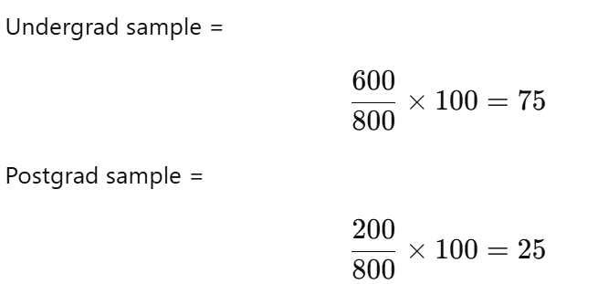
Stratified Sampling
A college has 800 students: 600 UG, 200 PG.
You want to sample 100 students using stratified sampling technique. How many students from UG and PG will be in your sample?

Slide 9
Systematic Sampling
In systematic sampling, you select every k-th item from an ordered list.
It’s simple, fast, and effective when your data is organized.
Select every k-th element.
Formula: k = N / n
Example: Survey every 10th customer entering a store.

Slide 10
Cluster Sampling
Divide into clusters.
Randomly select whole clusters.
Example: Randomly selecting 2 out of 5 schools and surveying all students inside.

Slide 11
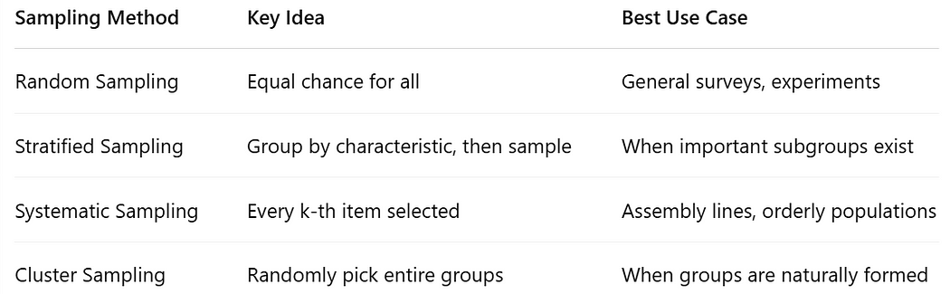
Comparison

Slide 12
Python Implementation

Slide 13
MCQ
1. Which sampling ensures proportional representation?
A) Random
B) Stratified
C) Cluster
2. Which method selects every k-th item?
A) Random
B) Systematic
C) Cluster

Slide 14
MCQ
1. Which sampling ensures proportional representation?
A) Random
B) Stratified ✅
C) Cluster
2. Which method selects every k-th item?
A) Random
B) Systematic ✅
C) Cluster

Slide 15
Session Summary
In this session, we have discussed about:
Understand the concept of sampling.
Understand different types of sampling and their use case.
Implementation of sampling techniques in Python!

Slide 16
Reference Links
Complete Guide to Sampling Methods: Random, Stratified, Systematic, and Cluster Sampling with Python Examples
Analyzing loan data with binomial and poisson distribution
10 Must-Know Probability Concepts for Every Aspiring Statistician and Data Scientist
Top 20 Interview Questions on Descriptive and Inferential Statistics
10 Must-Know Statistics Interview Questions (With Real Examples & Formulas!)

Slide 17

THANK YOU
For any Query:
Website- www.onlinecu.in
Helpline no.: 1800 121 388 800

